Slide 1
HIGH VOLTAGE ENGINEERING
In sem : 30 Marks End sem:70 Marks PR/OR: 25Marks Term Work: 25 Marks
Examination Scheme [150 Marks]
16/01/2020
1

Slide 2
Course Content:
Unit 01: Breakdown in Gases:
Unit 02: A) Breakdown in Liquid Dielectrics:
B) Breakdown in Solid Dielectrics:
Unit 03: Generation of High Voltages and Current:
Unit 04: Measurement of High Voltages and High Currents:
Unit 05: Lightning and Switching Over Voltages:
Unit 06: High Voltage Testing of Electrical Apparatus and HV Laboratories:
16/01/2020
2

Slide 3
Unit 1 :Breakdown in Gases
Ionization Process in Gas
Townsend’s Theory
Current growth equation in presence of primary and secondary ionization processes
Townsend’s breakdown criterion
Primary and Secondary ionization coefficients
Limitations of Townsend’s Theory
Streamer Mechanism of breakdown
Paschen’s law and its limitations
Corona discharges for point plane electrode combination with positive and negative pulse application
Time lag and factors on which time lag depends
¹⁶(/N^{01/}u²⁰m²⁰erical on Townsend’s theory and Paschen’s law)
3

Slide 4


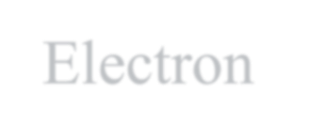








Ionisation
Primary Ionisation
Secondary Ionisation
Electron Attachment Process

Slide 5
What is Ionisation?
The process of liberating an electron from a gas molecule with the simultaneous production of positive ion.
Ionisation by Collision
Whenever you are applying high voltage over gaseous medium electrons will be generated.
These free electron collides with neutral gas molecule and give rise to new electron and a positive ion.
In fig. electron travels from cathode to anode. During this, it accelerates due to successive collisions with other gas molecules till it reaches anode.
Accelerating means it gains the Energy. If this Energy exceeds ionization potential, which is required to
dislodge an electron from atomic shell then ionization take place. This process can be given as:
𝑒⁻ + 𝐴 𝑒⁻ + 𝐴⁺ + 𝑒⁻
Where, A is the atom.
_{𝐴}+
_{𝑒}−
is positive ion. is electron.

Slide 6
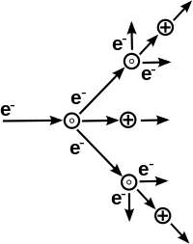
A few of the electrons produced at the cathode by some external energy, e.g. ultraviolet light falling on
cathode causes ionisation of neutral gas particles producing positive ions and additional electrons.
These additional electrons makes themselves collision causing ionization and thus process continues.
Hence there is increase in electron current. The number of electrons reaching anode per unit time is greater than those liberated at cathode. In addition, positive ions also reach cathode causing bombardment on cathode.
This gives rise to secondary electron.
Ultraviolet light
cathode Anode
_
+
I₀
R Current limiting
resistor
d
_
+
_
A
I
V_{B}
Adjustable HV source
Arrangement for study of a Townsend discharge

Slide 7
Photo Ionisation
This involves interaction of radiation with matter. Photo Ionisation process takes place when the amount of radiation energy absorbed by atom or molecule is more than Ionisation potential of that molecule.
There are several processes by which radiation can be absorbed by atoms or molecules. They are:
Excitation of atom to a higher energy state.
Continuous absorption by direct excitation of atom or dissociation of diatomic molecule or direct ionization etc.
An excited atom emits radiation when electron returns to lower state, when an atom absorbs radiation the reverse process take place this can be expressed as:
_{𝐴}∗
≤ C. h/Vi
hV + A
Ionisation occurs when ………… λ
Where h------ planks constant, c----- Velocity of light, Vi -------- ionization energy of atom
λ≤ (1.27/𝑉_{𝑖}) * 10⁻⁶
Greater the ionization energy lesser will be wavelength of radiation that causes ionization.
Radiation with wavelength of 1250 A is sufficient to cause photo ionization of almost all gases.

Slide 8
Secondary Ionisation Process
It is the process of liberation of free electrons from cathode surface by impact of positive ion,
metastable or photons on cathode surface.
Electron Emission due to Positive Ion Impact
Positive ions are formed due to primary ionization and being positively charged, they travel
towards cathode.
When positive ion approaches a metallic cathode, it causes emission of electrons from cathode.
In this process the positive ion gives away its kinetic energy. If the ionization energy is greater than twice work function of metal, then one electron will be ejected and a second electron will neutralize the ion.
The probability of this process is measured as γi
Which is called Townsend’s secondary Ionisation co-efficient due to positive ions and is defined as
net yield of electrons per incident positive ions.

Slide 9
Electron Emission due to Photons
If the electron is to be dislodged from outer shell, it should be given enough energy so that it
overcomes surface potential barrier.
The external energy can be supplied in the form of photon of UV light of suitable frequency.
The electron emission from metal surface takes place at a critical condition given by,
h.v ≥ ф
Where ф is work function of metallic electrode.
The frequency is given relationship,
V= ^{ф}
ℎ
Which is called Threshold frequency.

Slide 10
Electron Emission due to Metastable & Neutral Atoms
A metastable atom or molecule is an excited particle. The lifetime of such metastable atom is very large
(10⁻³s) compared to lifetime of an ordinary particle ( 10⁻⁸s).
The electrons can be made to eject from metal surface by means of an impact of an metastable atom.
The total energy should be sufficient to overcome work function. This process is only observed in metastable atoms but life time of other excited states is very short so these can not reach cathode surface and thus can not cause electron emission.
The emission take place in such cases only if these are very near to cathode.

Slide 11
Electron attachment process
Attachment collision is a process in which electrons may become attached to atoms or molecules to
form negative ions.
This process depends on energy of electron and nature of gas.
This process can be represented as:
Atom + 𝑒⁻ + K (negative atomic ion) + [Ea+K]
The energy liberated is kinetic energy (K) plus electron affinity (Ea).
The outermost orbit of attaching gases or insulating gases has vacancies. Thus these are supposed
to process affinity for electrons.
The free electrons present in ionized gas are absorbed due to vacancies.
This process take place in circuit breakers. Due to separation of circuit breaker contacts, the space between contacts gets ionized and dielectric strength between these contacts rapidly built up using suitable medium like insulating gas.
If it is done the arc does not restrike. Thus arc interruption process involves electron attachment
process. This process is due importance in switchgears.

Slide 12
Townsend’s Current Growth Equation

Slide 13
Townsend’s Current Growth Equation (Considering Primary and Secondary Ionisation Both)

Slide 14
Townsend’s Criterion for Breakdown
_{I e}αd
I =
0
α
1− γ (e ^{d} −1)
This equation gives total average current in a gap before occurrence breakdown. As distance between electrodes d is increased, the denominator of equation tends to zero, and some critical distance.
d=𝑑_{𝑠}
1- γ ( 𝑒^{α𝑑}-1)=0
For values of d < 𝑑_{𝑠} , I is approximately equal to Io and if external source for supply of Io is removed, I becomes zero.
If d=𝑑_{𝑠}, I ∞ and current limited only by resistance of power supply and external circuit. This condition is called Townsend’s breakdown criterion and can be written as γ ( 𝑒^{α𝑑}-1 )= 1.
Normally, 𝑒^{α𝑑} is very large and hence above equation reduces to γ.𝑒^{α𝑑} =1.
For a given gap spacing and given value of voltage V which gives values of 𝛼 & 𝛾 satisfying the breakdown criterion is called “ Spark Breakdown Voltage(Vs)” and corresponding distance is called “ Sparking Distance(ds)”.
Thus, Townsend’s mechanism explains the phenomenon of breakdown only at low pressure i.e. corresponding to p*d (gap
pressure * gap distance) values of 1000 Torr.cm and below.

Slide 15
Limitations/ Drawbacks of Townsend’s theory of Breakdown)
Townsend’s stated that breakdown is due to current growth and current growth is due to primary and secondary Ionisation. But in practice breakdown is also dependent on gas pressure (p) and gap distance (d).
•
This mechanism predicts time lag is of the order of 10⁻⁵ second. While actual breakdown occurs in very short
time i.e. 10⁻⁸ second.
Townsend’s predicted diffused and regular form of discharge while actual discharge is irregular and filamentary.
As Townsend’s failed to explain all these observed phenomenon, around 1940 Raether, Meek and Loeb proposed
a theory called as STREAMER THEORY.

Slide 16

Factors influencing breakdown in gases
Distance between Electrodes
Shape of Electrode
Size of Electrode.
Material of Electrode ( Cu, Brass, Steel)
Material between Electrodes ( Solid, Liquid, Gas)
Temperature
Pressure
Applied Voltage
Polarity of small electrode
Humidity
Dust
Irradiation
Nearby Earthed Objects
Miscellaneous.

Slide 17
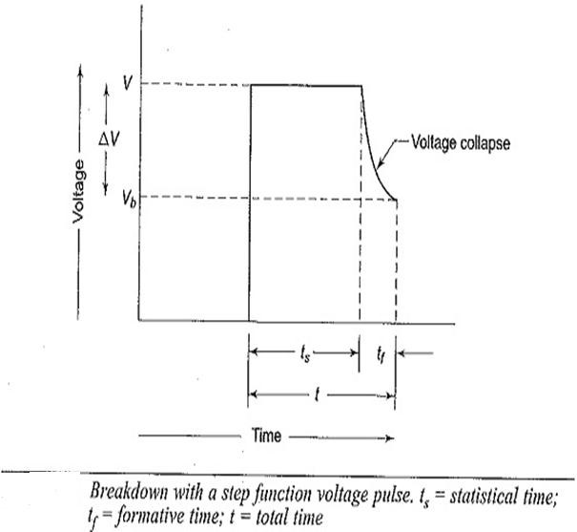
Time lags for breakdown
Time difference between application of voltage sufficient to cause breakdown and occurrence of dielectric breakdown.
The Townsend’s criterion is satisfied only if at least one electron is present in the gap between electrodes. In the case of applied dc or slowly varying (50 Hz ac ) voltages, there is no difficulty in satisfying this condition.
However with rapidly changing voltages of short duration the initiatory electron may not be present in gap, and absence of such electron breakdown can not occur.
The time t which lapses between application of voltage sufficient to cause breakdown and appearance of initiating electron (primary electron) is called statistical time lag (ts).
The appearance of electrons is usually statistically distributed. After breakdown i.e. after the appearance of electron, a time 𝑡_{𝑓} is required for the ionization processes to develop fully to cause breakdown of gap.(formation of secondary electron) This time is known as formative time lag (𝑡_{𝑓} )
The total time t = 𝑡_{𝑓} + 𝑡_{𝑠}. Is called total time lag as shown in below figure.

Slide 18
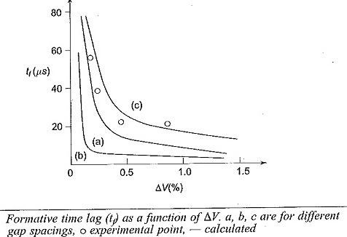
For the breakdown to occur, the applied voltage V should be greater than static breakdown voltage Vb as
shown in figure.
The difference in voltage ∆𝑉 = 𝑉 − 𝑉𝑏 is called over voltage and the ratio V/Vs is called impulse ratio.
The variation of 𝑡_{𝑓} with over voltage ∆𝑉 is shown in figure.

Slide 19
Factor affecting on Statistical time ( 𝒕_{𝒔} )
Factor affecting on Time of Formation ( 𝒕_{𝒇} )
Time required for an initiating electron to arrive in gap.
Time required exciting an initiating electron due to
irradiation, cosmic rays or sun rays.
Time required for dust particle to force in gap and get charged.
Time required for collision of an initiating electron with gas electrode.
𝛼 which is Townsend’s primary ionization coefficient.
𝛾 which is Townsend’s secondary ionization coefficient

Slide 20
Breakdown in Electronegative Gases
Attachment collision is a process in which electrons may become attached to atoms or molecules to form negative ions.
Since negative ions like positive ions are too massive to produce ionization due to collisions, attachment presents an effective way of removing electrons which otherwise would have led to current growth and breakdown at low-voltage. The gases in which attachment plays an active role are called electronegative gases.
Gases which are lacking in one or two electrons in their outer shell are known as Electronegative gases.
The most common attachment processes encountered in gases are:
The direct attachment in which an electron directly attaches to form negative ion. i.e. captured electron can be released by
absorption of photon.
AB + e 𝐴𝐵⁻ + hv
The dissociative attachment in which gas molecules split into their constituent atoms and electronegative atoms forms a
negative ion.
AB + e A + 𝐵⁻ + e
A simple gas of this type is oxygen. Other gases are sulphur hexafluoride, Freon, carbon dioxide, fluorocarbons.
In these gases A is sulphur or carbon atom and B is oxygen atom or one o the halogen atoms or molecules.
With such gases, Townsend’s current growth equation is modified to include ionization and attachment.
An attachment coefficient (n) is defined, similar to 𝛼, as number of attaching collisions made by one electron drifting one
centimeter in direction of field.

Slide 21
I=𝐼_{𝑜} [ { 𝛼/(𝛼 − 𝑛)} 𝑒 ^{𝛼−𝑛 𝑑}] − [ 𝑛/ (𝛼 − 𝑛) ]
1- { 𝛾
𝛼
_{[ 𝑒} 𝛼−𝑛 𝑑
− 1]}
𝛼−𝑛
The Townsend’s breakdown criterion or attaching gases can also be deduced as,
𝛾
𝛼
[𝑒 ^{𝛼−𝑛 𝑑}- 1] = 1
𝛼−𝑛
This shows that for 𝛼 > 𝑛 , breakdown is always possible irrespective of values of 𝛼, 𝑛 & 𝛾.
If n> 𝛼 ,
𝛾
𝛼 𝑛
= 1 or 𝛼 =
𝛼−𝑛 1−𝛾
n--- attachment coefficient

Slide 22
Paschen’s Law
Studied various breakdown voltage for different gases, as pressure and distance varied.
Breakdown voltage is a function of product of pressure and distance
V= (pd)
The Townsend’s criterion γ ( 𝑒^{α𝑑}-1)= 1
enables the evaluation of breakdown voltage of gap by the use of appropriate values of 𝛼/𝑝 and γ corresponding to
values E/p when current is too low to damage cathode and also space charge distortions are minimum.
An expression for breakdown voltage for uniform field gaps as a function of gap length and gas pressure can be derived
from threshold equation by expressing ionization coefficient 𝛼/𝑝 as a function of field strength E and gas pressure p i.e.
𝛼/𝑝 = f ( E/p) ----------------------------------------------------------------------(1)
𝐸
𝛾 = 𝑓 −−−−−−−−−−−−−−−−−−−−−−−−−−−−−−−−−−−−− −(2)
2
𝑝
E=V/d ----------------------------------------------------------(3)
Substituting this we have
𝑓 ^{𝐸} 𝑝𝑑
𝑒 = 1/v + 1
𝑝

Slide 23
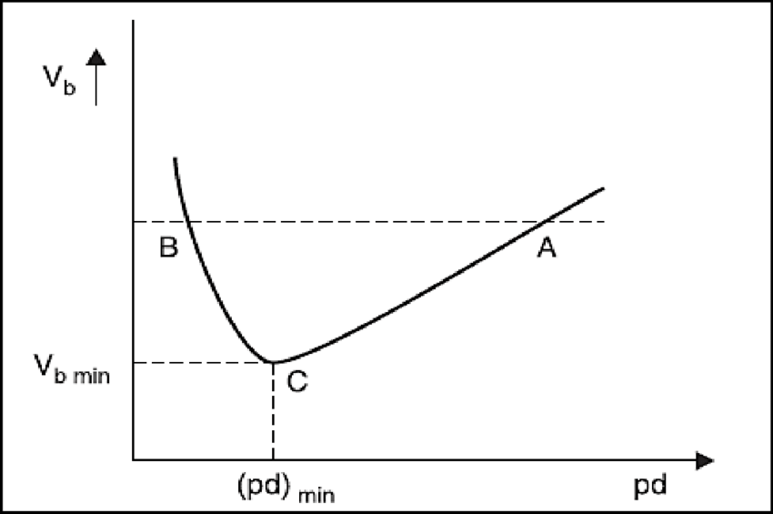
Taking log on both sides, we have f (E/p) pd = ln [1/v +1] = k
For uniform field E= ^{𝑉𝑏}
𝑑
f (^{𝑉𝑏} ). pd =k
𝑝𝑑
f (^{𝑉𝑏} ) = k / pd
𝑝𝑑
𝑉_{𝑏} = F (p.d) -----------(4)
This shows that breakdown voltage of uniform field gap is a unique function of product of gas pressure and gap length for a particular gas and electrode material. This relation is known as Paschen’s law.
•

Slide 24
Electric Discharge
The passage of current through dielectric gas is usually termed as electric discharges in gases.
This phenomenon is observed when a gas usually a non-conductor carries charge carrier in addition to general gas atoms on molecules and becomes electrically conducting.
Types of Electric discharges in a gas
1. Non self sustaining discharge
Glow Discharge or Decay Discharge
Spark Discharge
Arc Discharge
Corona Discharge
2. Self Sustaining Discharge

Slide 25
Non-Self sustaining Discharge
At a voltage, lower than BDV, the current in gas is due to presence of an external ionizer which continuously produces electrons and ions in inter electrode space.
If this external ionizer is taken away, the current immediately ceases to flow in space and ionization under action of
applied electric field ceases.
This process is non-self sustaining one i.e. it can not maintain itself only at expense of internal resource of gaseous space.
At voltage equal to breakdown voltage the process becomes self sustaining i.e. it does not, any more depend upon help of external ionizer.
Depending upon electric field configuration power of source and gas pressure, it is possible to get several types o electric discharge.
Glow Discharge or Decay Discharge
This type of discharge is produced at low gas pressure.
The gas can not acquire a high conductivity even at high ionization because of insufficient number of gas molecules per
unit volume.
This type of discharge usually occupies all the space , between electrodes ad current passing through gas is not very
large.

Slide 26
Spark Discharge
This type is characterized by
(micro-second)
a high voltage gradient and passage of low current or externally short duration of time
Example: Lightning is one of forms of Spark discharge.
ARC Discharge
This type is characterized by passage of high current at relatively low voltage.
This type of discharge is very luminous and noisy. When voltage is less than 20v and current density is in the range of
10^3 to 10^7 A/cm2 a heavy arc is produced between electrodes.
Used in welding and other electro-thermal processes.

Slide 27
Corona Discharge
Def: If the potential difference between two electrodes is
greater than threshold value then corona occurs.
Corona is defined as self-sustained electric discharge in which field intensified ionization is localized only over portion of distance( non-uniform field) between electrodes.
Corona Results:
Production of Ozone
Hissing Noise
Violet glow
How to reduce Corona
Increase conductor size
Bundled conductor
Use hollow conductor
Use corona guard rings
Increase conductor spacing
Advantages
Reduces Electrostatic stress between conductors
Disadvantges
Power loss
Transmission efficiency reduces
Electromagnetic Interference problem
Corrosion
Damage of insulation
Applications of CORONA’
ESP
High speed printing devices
Paint sprayers.

Slide 28
Point Of Comparison | Uniform Field | Non-Uniform field
Definition | When Electric Field Intensity is same everywhere in a gap and also on both electrode surfaces then it is known as uniform field | When Electric Field Intensity is different everywhere in a gap and also on both electrode surfaces then it is known as non uniform field
Example | Sphere- Sphere, Rod- Rod, Plate-Plate, etc. | Point- Electrodes, Sphere-Rod, Flat-Sphere etc.
Breakdown Phenomenon | When field is uniform ionization occurs everywhere in gap due to uniform field intensity and breakdown is observed with spark. | In non-uniform field ionization occurs near electrode surface having high field intensity and breakdown occurs with partial discharge and corona.
Corona | There is no corona discharge | Corona discharge occurs.
Theory | Townsend’s theory is applied for studying | Streamers theory is used for explaining breakdown.
Nature of Breakdown | Breakdown is easy to understand. | Difficult to understand.

Slide 29
Development of Theory | Breakdown process is developed satisfactorily. | Theory is Still under development
Breakdown Voltage | BDV is high | BDV is low
Effect of polarity | Breakdown is not affected due to polarity of electrodes. | Breakdown is affected due to polarity of electrodes.
Current | With increase in applied voltage, current through gap increases steadily | Increase in applied voltage does not increase current steadily.
Breakdown Criterion | γ ( 𝑒^{α𝑑}-1)= 1 | 𝛾. [exp ^{𝑑}(𝛼. 𝑑𝑥) − 1 ]=0 0

Slide 30
Positive Corona | Negative Corona
With Positive electrode corona discharge is in form of uniform sheath all over conductor surface | With negative electrode corona discharge is spotty or filamentary all over the conductor surface.
It appears smaller than negative corona | It appears greater than positive corona
With increase in voltage current increase steadily | Current increases in form of trichel charges with increase in applied voltage.
The total number of electrons and electron density is low | The total number of electrons and electron density is more.
BDV: Low | BDV: high
Corona discharge occurs at higher voltage | Corona discharge occurs at lower voltage
Energy level is very high | Energy level is relatively low.
It generates much less ozone than negative corona | It generates much more ozone than positive corona
The secondary electron generated by ionization caused by photons emitted from plasma | The dominant process for secondary electron is photo electric effect from surface of electrode itself.
The electrons resulting from ionization attached towards the curved electrode. | The general movement of electron in negative corona is outward from curved electrode.
The color of this corona is bluish white. | The color of this corona is reddish
They are simple in construction | They are quite complex in construction
1
6/01/2020
30

Slide 31
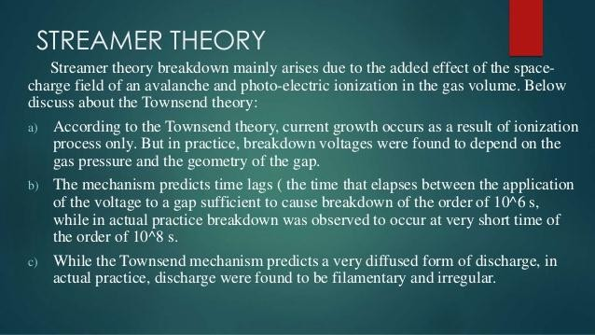
31

Slide 32
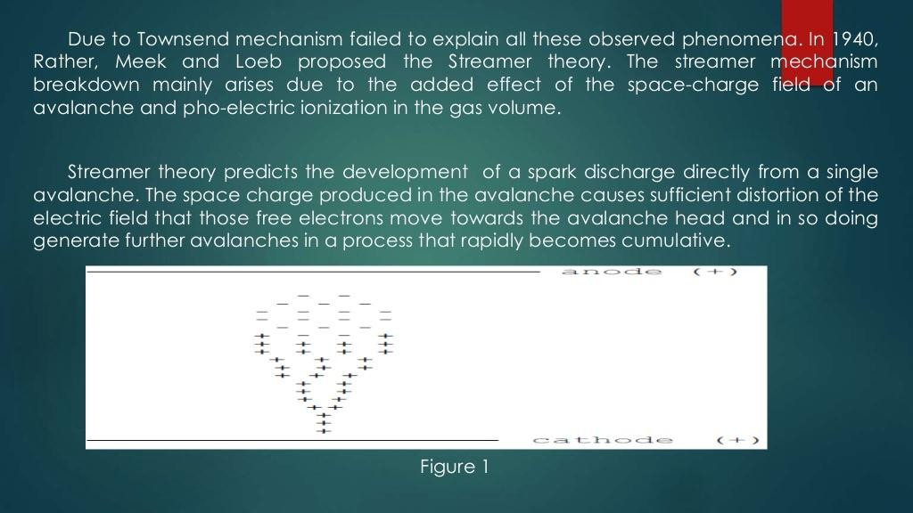
32

Slide 33
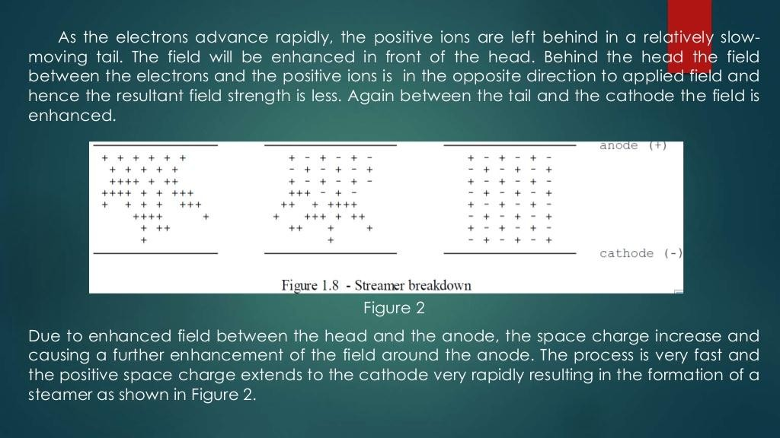
33

Slide 34
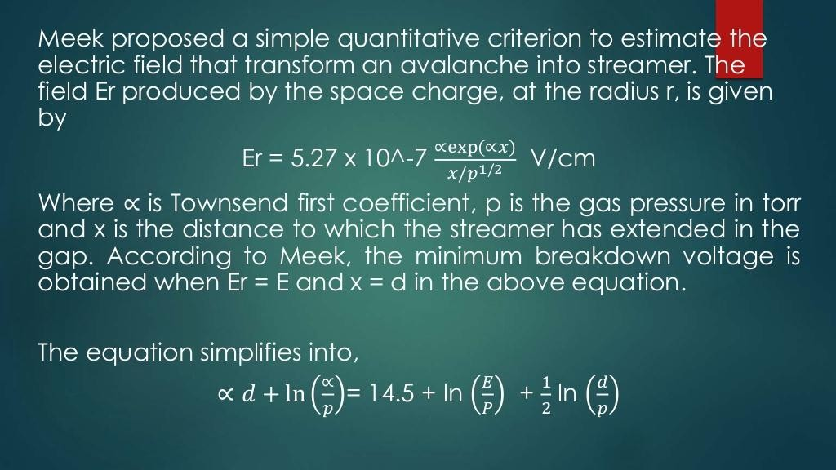
34

